Slide 1
Please complete the University Course Eval! https://tamu.aefis.net
Should take only 2-10 minutes, depending on whether you are willing to leave comments, too. I hope you will, and the more specific, the better.
My Promise: If you leave comments, I WILL READ them. Previous student comments have led me to change my course design in big and small ways.

Slide 2
Poverty & State Policy
Chapter 12A, Part 1
Tough Issue #1: Poverty (Part 1)
Dr. Dwight Roblyer

Slide 3
Learning Objectives
Explain the concept of poverty as both a relative and ubiquitous condition.
Compare and contrast generational and situational poverty and their non-monetary effects.
Describe how hidden rules work and are different based on one’s socio-economic status.
Define the poverty measure used by the federal and state governments, then describe the problems associated with it, how they came about, and why they likely won’t be fixed soon.
Explain what Francis Deviney’s group devised as an alternative measure of poverty and how it compared to the official measure.
Characterize the prevalence of official poverty among wage workers and the education levels of those who are officially impoverished.

Slide 4
Learning Objectives
Describe the general frequency of residents making at or less than the poverty line, as well as between the poverty line and 2-times that amount in the 10 states with the most low-wage workers.
Describe what a “low-wage” job is and how low-wage differs from minimum-wage.
Describe the prevalence of low-wage jobs in Texas and how the lack of full-time hours and absence of benefits contributes to poverty in Texas.
Explain the disconnect between overall economic health of Texas and the economic security of its residents.
Define liquid-asset poor and how this is a problem for even middle-class families.

Slide 5
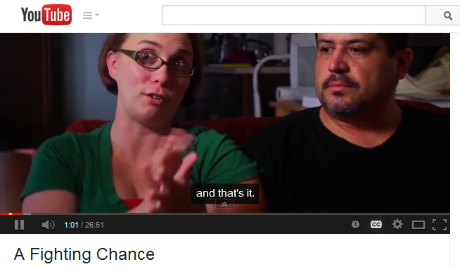
What is poverty & who are the impoverished?
http://youtu.be/CLnD1u05G4A
(first 8:40)
Center for Public Policy Priorities
Non-partisan, non-profit liberal-leaning “think tank”
http://forabettertexas.org/

Slide 6
Key Points about Poverty
It is a relative condition
Someone you label as in poverty may not see themselves that way, but instead someone else that is struggling more than them
It occurs in all races & all countries
It is the lower end of a continuous spectrum of economic class, without any precise starting point
Generational and situational poverty are 2 types
Generational: enduring phenomenon for >2 generations
Situational: circumstances-driven, lasts shorter time
Poverty is not just about too little money
Has pervasive effects on individuals & families: how they think, how they dream, how they interact with society
Even if income level rises, changes to thought patterns, social interactions, cognitive strategies come much more slowly
(Payne, Ruby K., A Framework for Understanding Poverty, 1996, pp2-3)

Slide 7
Key Points about Poverty
People raised in poverty bring with them different hidden rules than those of the middle class
“Could You Survive in Poverty?” (read by instructor)
Example of “Hidden Rules” concerning food:
Poverty: Quantity is important Did you have enough?
Middle Class: Quality is important Did you like it?
Wealth: Presentation is important Was it presented well?
Another example, concerning education:
Poverty: Valued and revered as abstract, but not as reality
Middle Class: Crucial for climbing success ladder and making money
Wealth: Necessary tradition for making and maintaining connections
People raised in poverty will be out of place in schools and businesses because rules there are those of middle-class
Should underlying, alien realities of poverty alter our proposed “solutions” to poverty problem?
(Payne, Ruby K., A Framework for Understanding Poverty, 1996, pp2-3, 42-43)

Slide 8
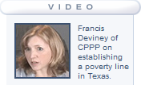
How Does Government Measure Poverty?
http://youtu.be/qdQilctPDWs
(5:36)
(CPPP = Center for Public Policy Priorities, a liberal-leaning think tank)
“Federal Poverty Line” is outdated measure based on tripling the cost of buying food for a year in 1963, then adjusted every year since then based on inflation
Major expense is no longer food
Major expenses now: housing, transportation, healthcare, childcare
Measure underestimates # of people experiencing poverty
This single number is used by feds and most states
NOT adjusted for cost of living, except in Alaska and Hawaii
Politicians don’t want to correct this measure “on their watch” because count of impoverished would increase sharply

Slide 9
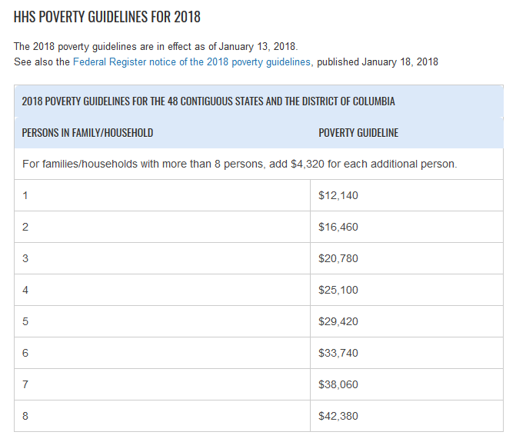
How Does Government Measure Poverty?
http://youtu.be/qdQilctPDWs
(5:36)
(CPPP = Center for Public Policy Priorities, a liberal-leaning think tank)
“Federal Poverty Line” is outdated measure based on tripling the cost of buying food for a year in 1963, then adjusted every year since then based on inflation
Major expense is no longer food
Major expenses now: housing, transportation, healthcare, childcare
Measure underestimates # of people experiencing poverty
This single number is used by feds and most states
NOT adjusted for cost of living, except in Alaska and Hawaii
Politicians don’t want to correct this measure “on their watch” because count of impoverished would increase sharply

Slide 10
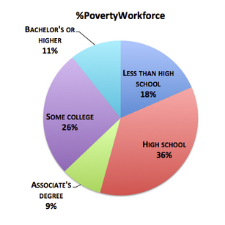
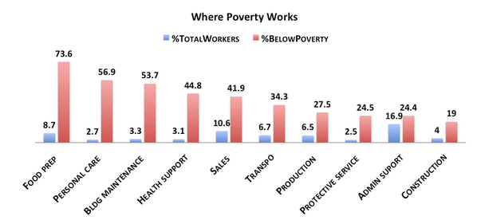
Jobs, Wages, Education & Poverty
States often point to jobs & education as keys to reducing poverty: “Take responsibility. Get a job! Get a degree!”
Not bad advice, but…
What if even full-time employment doesn’t pay enough or lead to advancement opportunities?
And what if education does not provide guaranteed protection against poverty?
of overall workforce
within that field
http://www.theatlantic.com/business/archive/2012/04/the-10-states-and-10-jobs-with-the-most-low-wage-workers/256553/

Slide 11
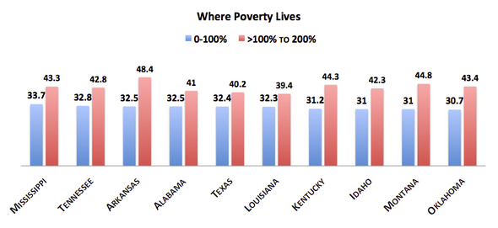
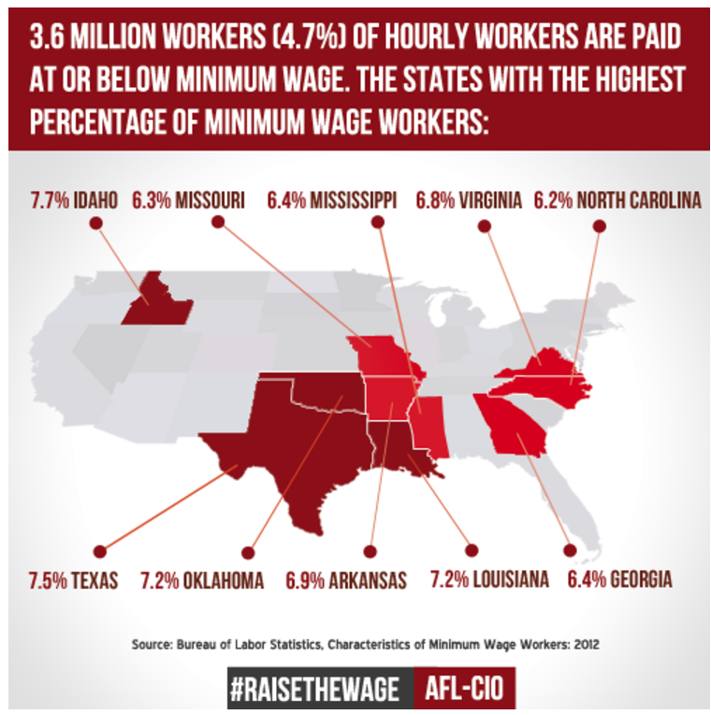
Jobs, Wages & Poverty
…percentages of all workers in that state, by amount of annual income
…where “100%” = $23,000 ( 2012 federal poverty line for family of 4) and “200%” = $46,000
These pairs are cumulative!
http://www.aflcio.org/Multimedia/Infographics/States-with-the-Highest-Percentage-of-Minimum-Wage-Workers
AFL-CIO = Really BIG labor union
They used this graphic to argue in favor of a federal increase to minimum wage
Note the ranking of Texas
http://www.theatlantic.com/business/archive/2012/04/the-10-states-and-10-jobs-with-the-most-low-wage-workers/256553/

Slide 12
What’s a “Low Wage?”
Start with the FPL for a family of 4
This is an annual wage amount
Divide by 2080, the number of work hours in 1 year
Assumes 40 hrs/week, 52 weeks/year
So in 2018, it was about $12/hour
So any wage below $12/hour was considered a “low wage” in 2018
How easy is it to get a job that pays less than $12/hour?
What about more than $12/hour?
What does this tell us?
https://www.texastribune.org/2014/01/30/study-half-texas-households-are-crisis-poverty/

Slide 13
What’s the Disconnect between Jobs & Poverty?
Many impoverished Texans have full-time jobs, or multiple part-time jobs
Why? Texas has a lot of low-wage jobs
>25% of jobs in state
Only 8 other states have more per capita
Very few low-wage employees can afford the basics (housing, childcare, food, healthcare, and transportation)
These employees often only offered 15-30 hours per week at each job, and offered no benefits
When Texans brag about adding jobs, important to ask what wages that those jobs are paying!
…So, is “Get a job!” a sufficient solution to the problem of poverty?
https://www.texastribune.org/2014/01/30/study-half-texas-households-are-crisis-poverty/

Slide 14
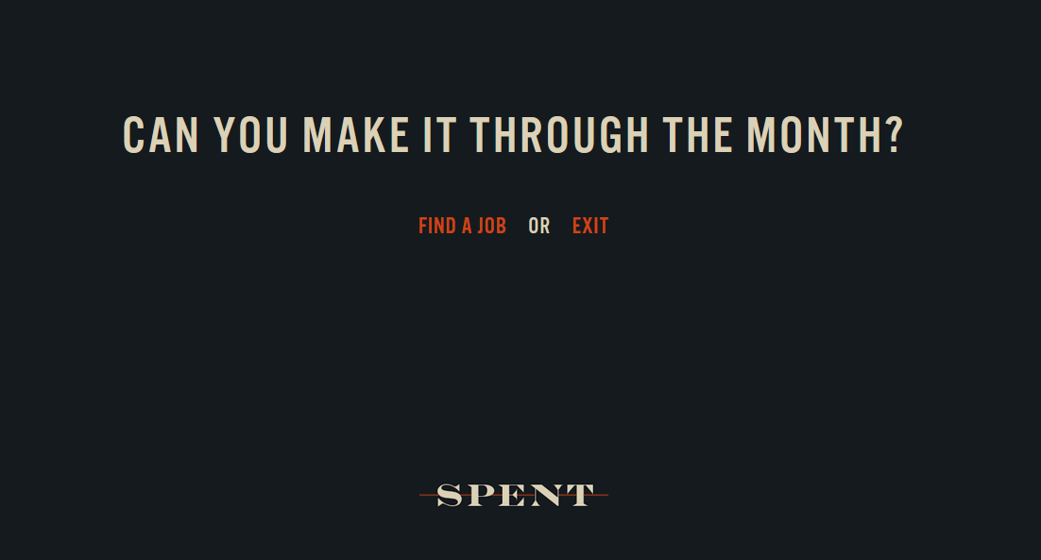
Take the Challenge: Play “Spent”
http://playspent.org/html/
Get an idea of how difficult it is to navigate a typical situation for someone in poverty
Experience a bit of the reality that, under conditions of poverty, circumstances drive choices more than one’s own resourcefulness
This is a simulation, so options offered to you will be frustratingly few—but isn’t’ that part of the point? Individuals in poverty have far more limited options than those with more economic resources and opportunities….

Slide 15
What’s the Disconnect between Jobs & Poverty?
The overall economic health of Texas doesn’t translate well into the economic well-being of a lot of its residents
In 2014, Texas ranked #1 in economic recovery, but #37 in residents’ overall financial security
49.8% of households were “Liquid asset poor”
Lack enough savings to pay for 3 months of basic expenses in case of crisis
Nearly one-third of middle-class households ($54K-$91K annual income) were only one crisis away from poverty
https://www.texastribune.org/2014/01/30/study-half-texas-households-are-crisis-poverty/

Slide 16
Practice Problems …to begin mastering this material. Complete instructions are in the Module 1 resource, How to Use Practice Problems to Prepare for Exams.
Don’t forget to do the…

Slide 17
Please complete the University Course Eval! https://tamu.aefis.net
Should take only 2-10 minutes, depending on whether you are willing to leave comments, too. I hope you will, and the more specific, the better.
My Promise: If you leave comments, I WILL READ them. Previous student comments have led me to change my course design in big and small ways.

